Slide 1

Chapter 1
Introduction
Copyright © The McGraw-Hill Companies, Inc. Permission required for reproduction or display.

Slide 2
1-1 DATA COMMUNICATIONS
The term telecommunication means communication at a distance. The word data refers to information presented in whatever form is agreed upon by the parties creating and using the data. Data communications are the exchange of data between two devices via some form of transmission medium such as a wire cable.
Topics discussed in this section:
Components of a data communications system
Data Flow

Slide 3
Characteristic of Data Communication System
Delivery: The system must deliver data to the correct destination. Data must be received by the intended device or user and only by that device or user
Accuracy: The system must deliver the data accurately. Data that have been altered in transmission and left uncorrected are unusable
Timeliness: The system must deliver data in a timely manner. Data delivered late are useless
Jitter: Jitter refers to the variation in the packet arrival time.

Slide 4
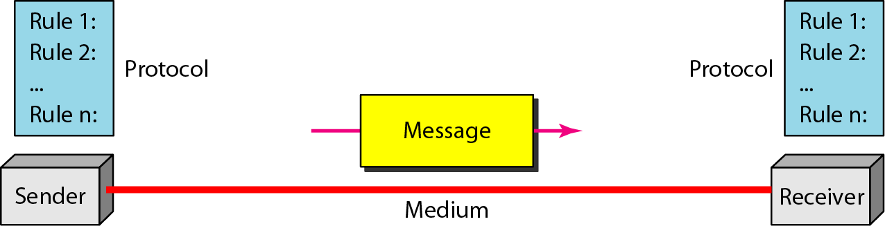
Figure 1.1 Components of a data communication system

Slide 5
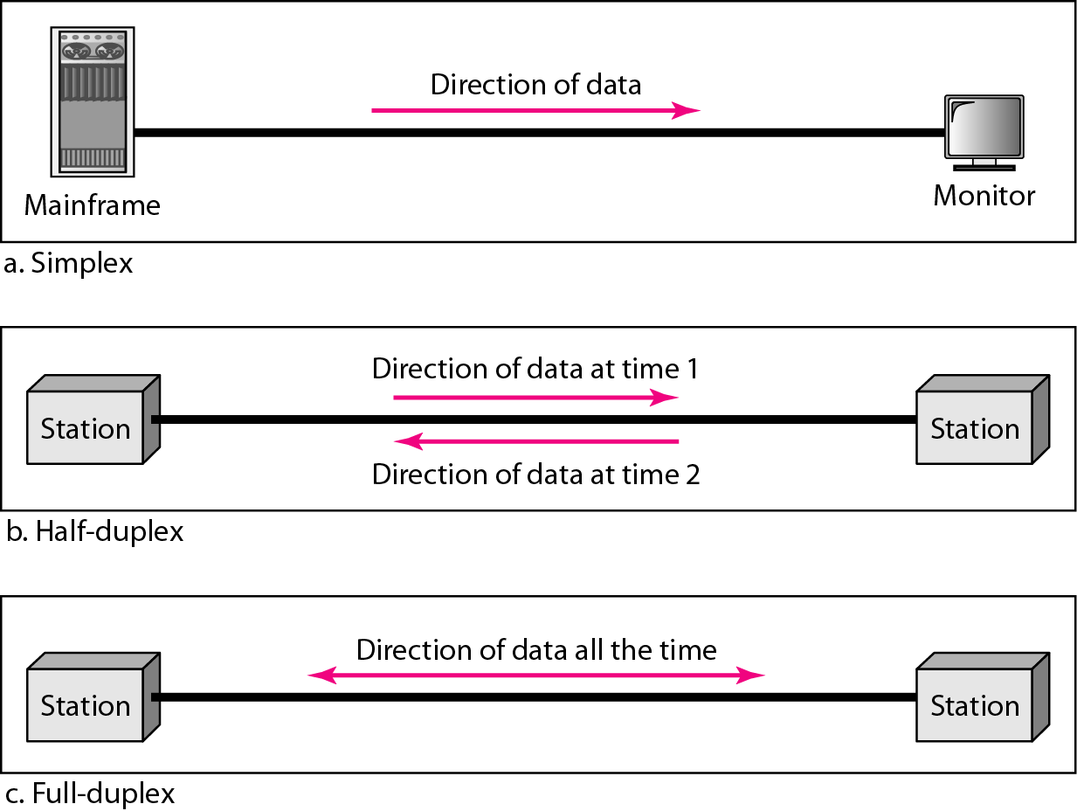
Figure 1.2 Data flow (simplex, half-duplex, and full-duplex)

Slide 6
1-2 NETWORKS
A network is a set of devices (often referred to as nodes) connected by communication links. A node can be a computer, printer, or any other device capable of sending and/or receiving data generated by other nodes on the network. A link can be a cable, air, optical fiber, or any medium which can transport a signal carrying information.
Topics discussed in this section:
Network Criteria
Physical Structures
Categories of Networks

Slide 7
Network Criteria
Performance
  Depends on Network Elements
  Measured in terms of Delay and Throughput: both are contradictory
Reliability
  Failure rate of network components
  Measured in terms of availability/robustness
Security
  Data protection against corruption/loss of data due to:
      Errors
      Malicious users

Slide 8
Physical Structures
Type of Connection
  Point to Point - single transmitter and receiver
  Multipoint - multiple recipients of single transmission
Physical Topology
  Connection of devices
  Type of transmission - unicast, mulitcast, broadcast

Slide 9
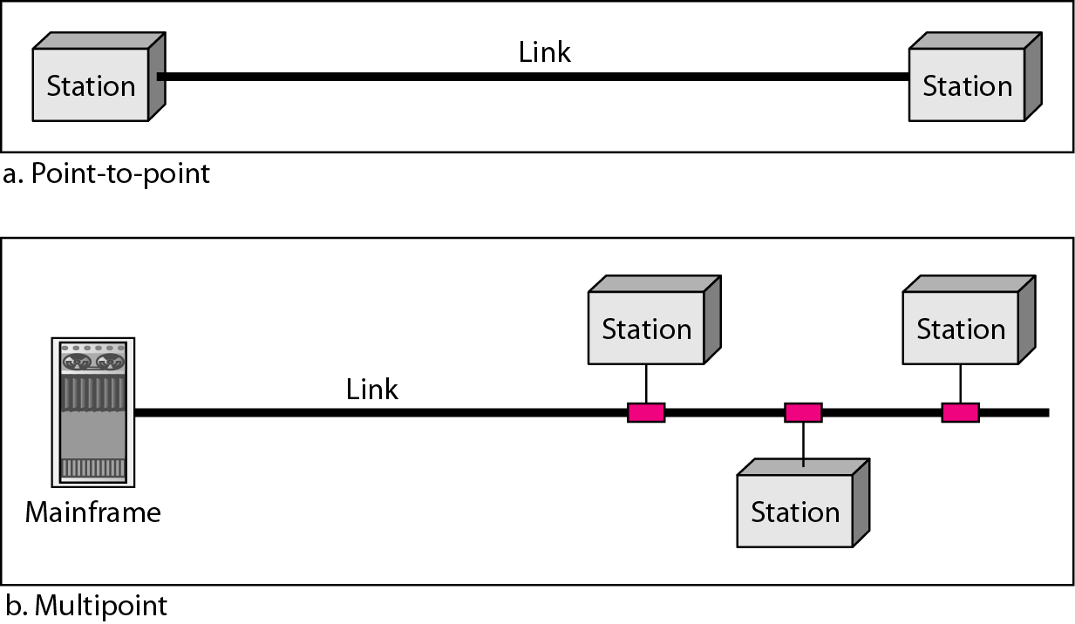
Figure 1.3 Types of connections: point-to-point and multipoint

Slide 10
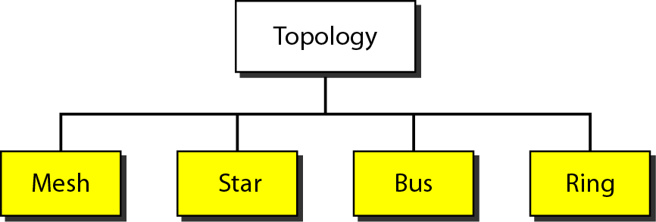
Figure 1.4 Categories of topology

Slide 11
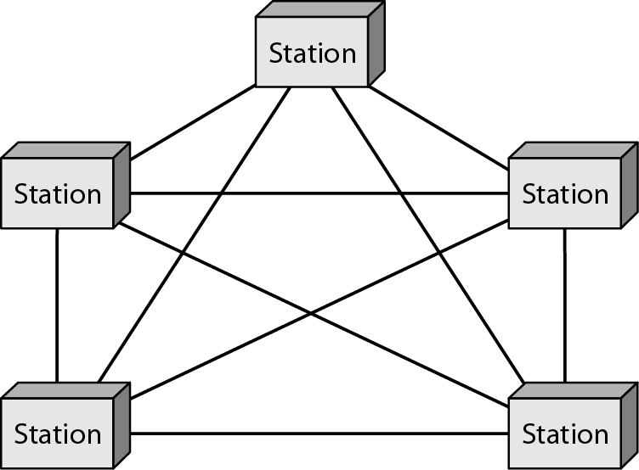
Figure 1.5 A fully connected mesh topology (five devices)

Slide 12
Each node connected to n-1 nodes
Total links: n(n-1)
For duplex: half of it

Slide 13
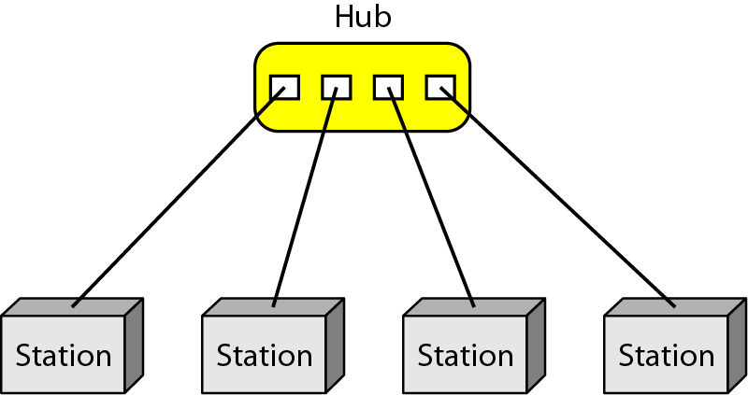
Figure 1.6 A star topology connecting four stations

Slide 14
Controller is an exchanger
Central dependency: both good and bad
Robust
Use: LAN

Slide 15
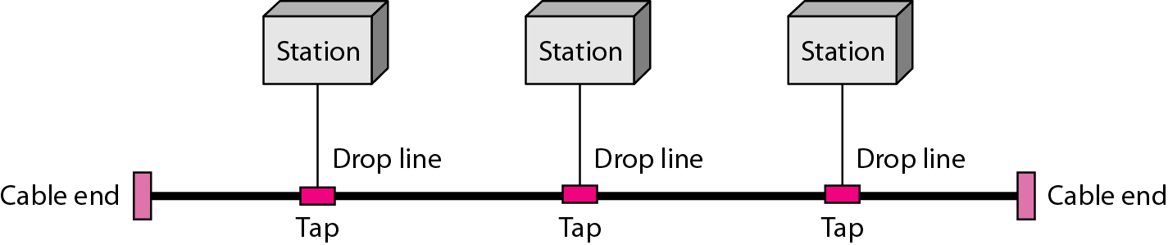
Figure 1.7 A bus topology connecting three stations

Slide 16
Multipoint
Connected via drop lines
Difficult reconnection , fault isolation
Signal reflection at taps: degradation in quality
Difficult to add new device

Slide 17
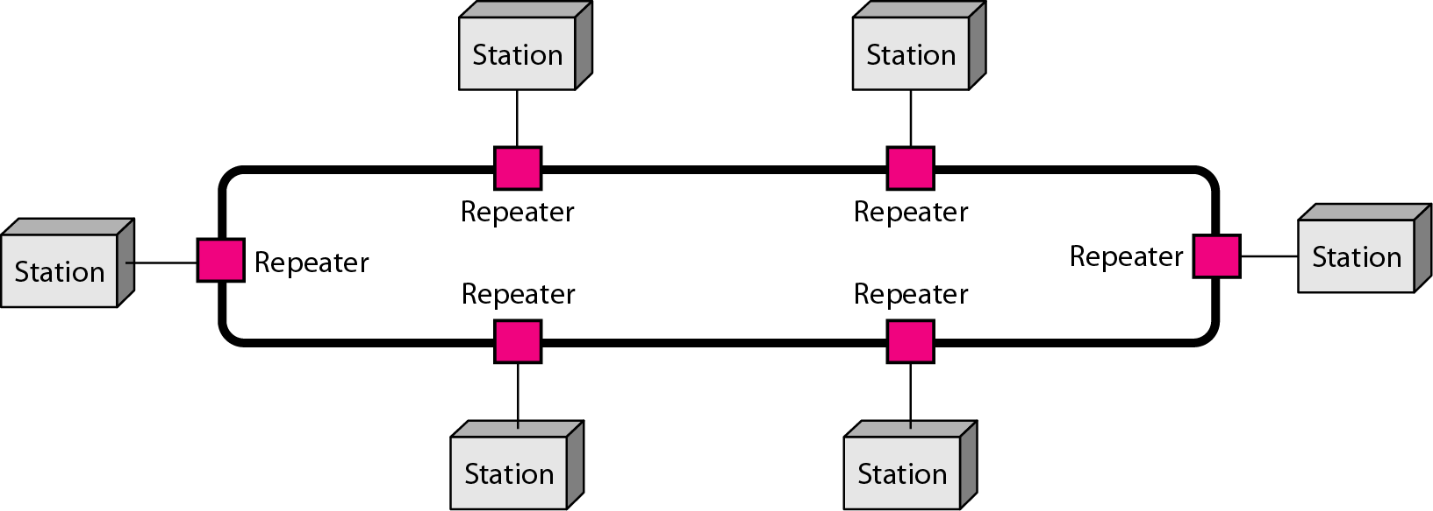
Figure 1.8 A ring topology connecting six stations

Slide 18
Easy to install and reconfigure
Connection to its immediate neighbor only
Modification: change only two entries
Easy fault isolation
Can result in whole network break

Slide 19
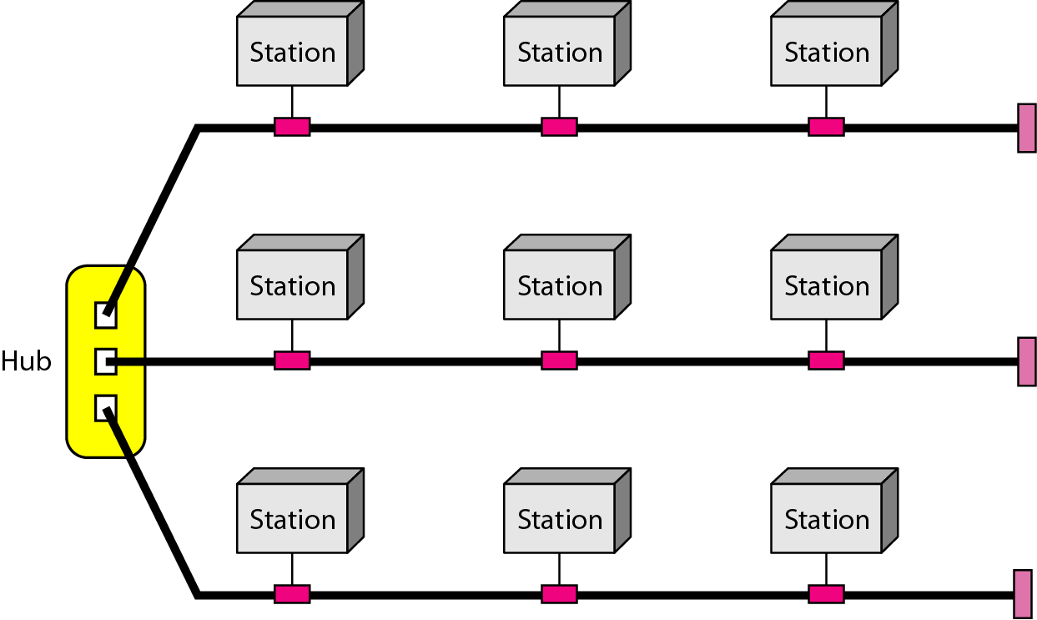
Figure 1.9 A hybrid topology: a star backbone with three bus networks

Slide 20
Categories of Networks
Local Area Networks (LANs)
  Short distances
  Designed to provide local interconnectivity
  As simple as connecting two PC or can occupy a company
  Recourse sharing: HW, SW, Data
  Mostly bus, ring and star
Wide Area Networks (WANs)
  Long distances: may comprise countries
  Provide connectivity over large areas
Metropolitan Area Networks (MANs)
  Provide connectivity over areas such as a city, a campus

Slide 21
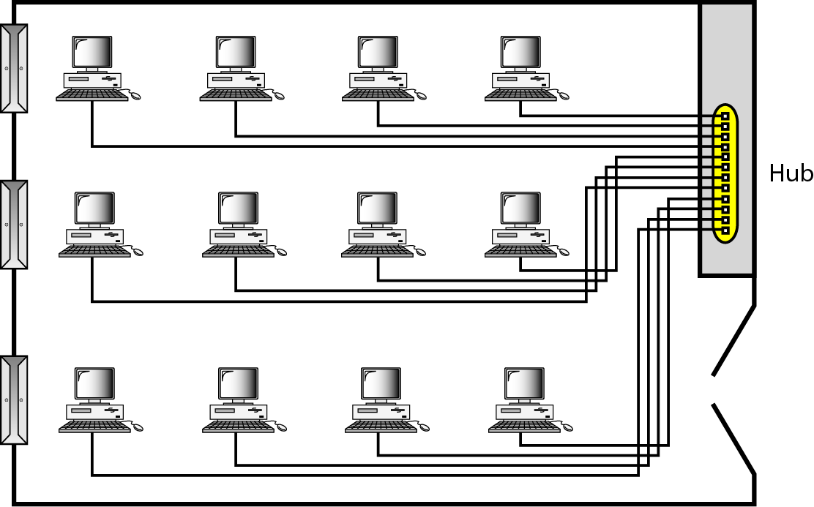
Figure 1.10 An isolated LAN connecting 12 computers to a hub in a closet

Slide 22
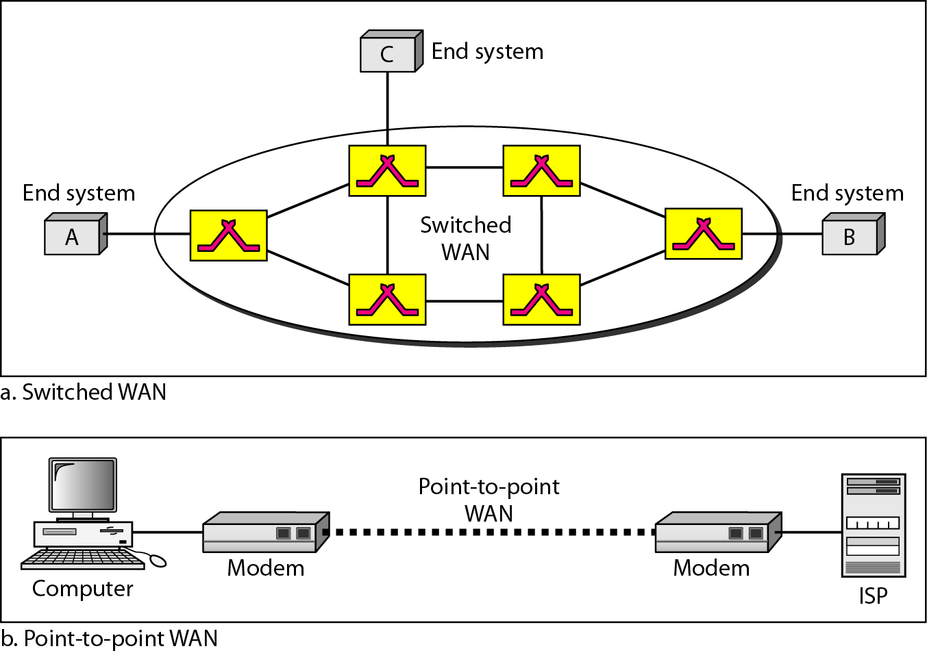
Figure 1.11 WANs: a switched WAN and a point-to-point WAN

Slide 23
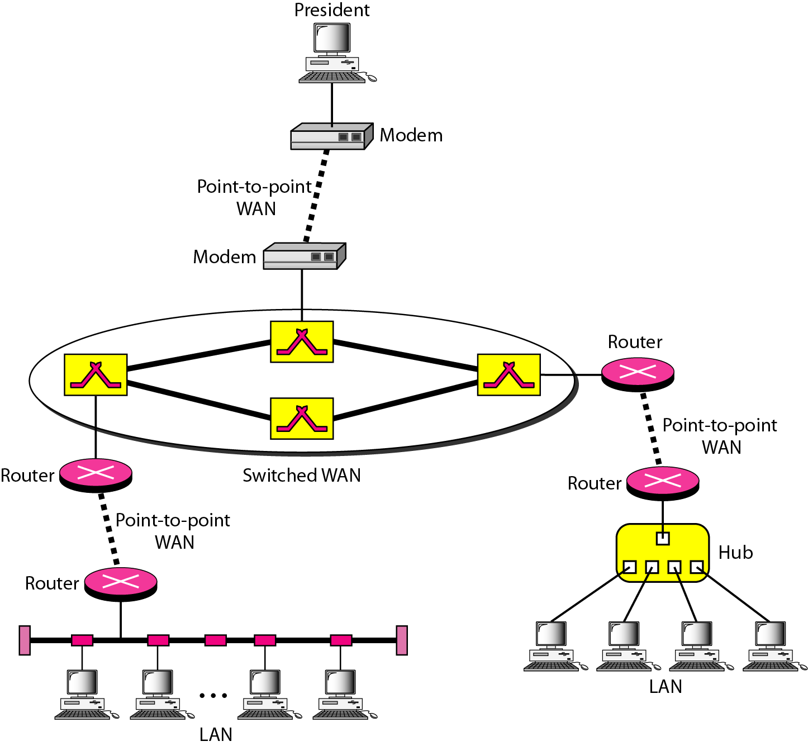
Figure 1.12 A heterogeneous network made of four WANs and two LANs

Slide 24
1-3 THE INTERNET
The Internet has revolutionized many aspects of our daily lives. It has affected the way we do business as well as the way we spend our leisure time. The Internet is a communication system that has brought a wealth of information to our fingertips and organized it for our use.
Topics discussed in this section:
Organization of the Internet
Internet Service Providers (ISPs)

Slide 25
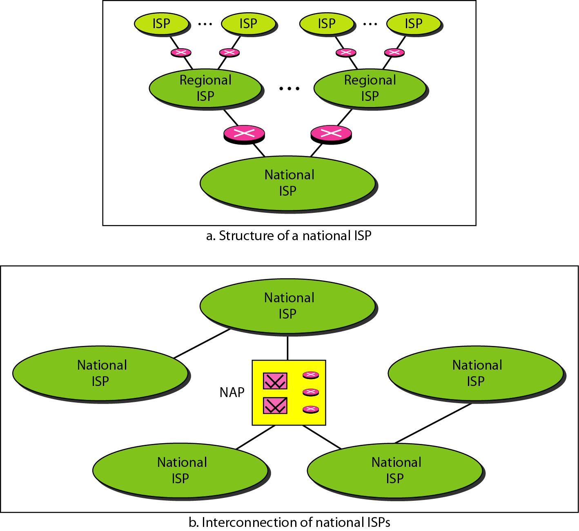
Figure 1.13 Hierarchical organization of the Internet

Slide 26
1-4 PROTOCOLS
A protocol is synonymous with rule. It consists of a set of rules that govern data communications. It determines what is communicated, how it is communicated and when it is communicated. The key elements of a protocol are syntax, semantics and timing
Topics discussed in this section:
Syntax
Semantics
Timing

Slide 27
Elements of a Protocol
Syntax
  Structure or format of the data
  Indicates how to read the bits - field delineation
Semantics
  Interprets the meaning of the bits
  Knows which fields define what action
Timing
  When data should be sent
  Speed at which data should be sent or speed at which it is being received.

